Slide 1
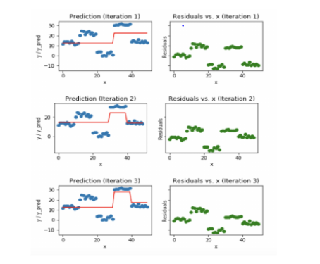
Extreme boost or XG Boost Algorithm
XGBoost is An Optimized Enhancement Of Gradient Boosting. In Boosting, Weights Are Added To The Model Based On The Residuals. However, In Gradient Boosted The Loss Function Is Optimized To Correct Errors Made By Previous Models. XGBoost Introduces New Features To Gradient Boosting Like Regularization, Tree Pruning, And Parallel Processing.

Slide 2
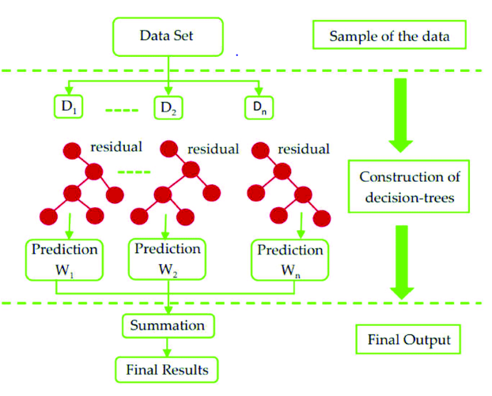
Structure of a XGBoost model

Slide 3
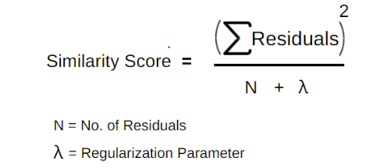
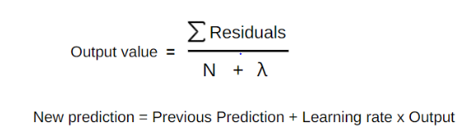
Formula used in XGBoost
Residual (yi – F0(x))

Slide 4
How XG Boost Algorithm Works
The Average Of The Five Marks Is 40. Which Will Be The Prediction Of The Base Model.
The Residuals For The First Five Readings Are -19, 7, -13, 35 And -10, Respectively. (ex: Marks obtained 21-Average 40=-19)
Residuals used to Construct The Decision Tree With Splitting Criteria ie Hours Studied Greater Than 3.5, Then Calculate The Similarity Scores For The Root And Leaf Nodes.
Λ In The Equation Is The Regularization Parameter.
Once the Gain is calculated the Auto Tree Pruning Is Complete. For This Purpose, We Use The Gamma Parameter In XGboost Regression.
If The Gain Is Less Than The Gamma Value Then The Branch Is Cut And No Further Splitting Takes Place Else Splitting Continues.
If The Value Of Gamma Is More, More Pruning Takes Place.
XGBoost is a good algorithm for datasets less than 10000 rows, for large datasets, it is not recommended.

Slide 5
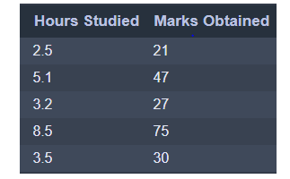
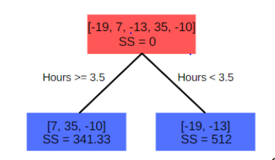
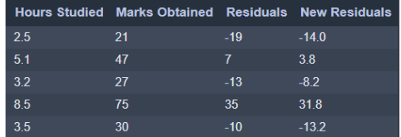
Sample data

